Slide 1
Inside A PC
Computer Science

Slide 2
Inside PC Labeled
Optical Disk Drive (e.g.DVD)
Hard Disk Drive
Power Supply
Cooling Fan
Motherboard
Audio Ports/Ethernet Cables/Monitor Ports/USB Expansion Ports

Slide 3
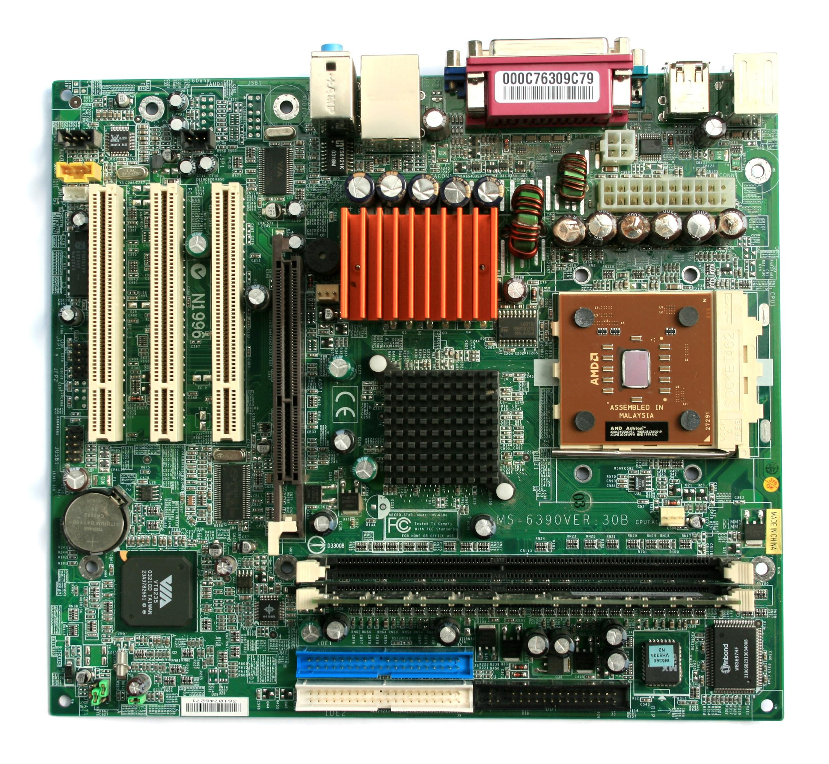
Motherboard
Disk Drive Interface
GPU
Sound Processor
WiFi ethernet cable
CPU
RAM Memory

Slide 4
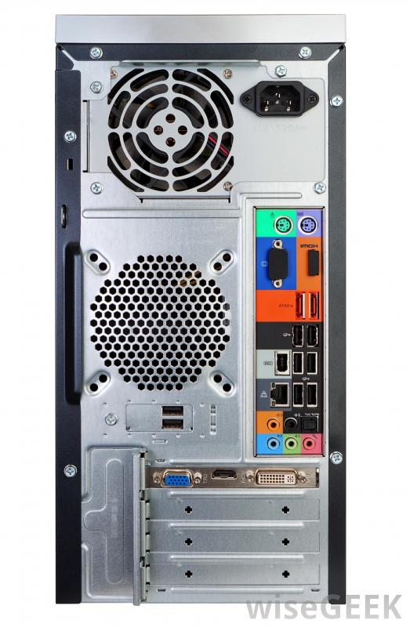
Behind PC Labeled
Power Chord
USB Ports.
Monitor Interface
Ethernet Interface
Keyboard Interface\Mouse Interface
Audio Input/Outputs
Monitor Port

